Slide 1



Notes:
This can be used for whole staff CPD or also for teachers to work through themselves after as a reminder, There are hyper links to additional reading and videos in the ppt. These can be used within the session or for staff to work through or use as support in addition to the session. The hidden slides are the ones for more individual use. The sort cards are at the end of the presentation. This CPD tries to fit in with the research from the EEF : A Balanced Approach to Professional Development.

Slide 2
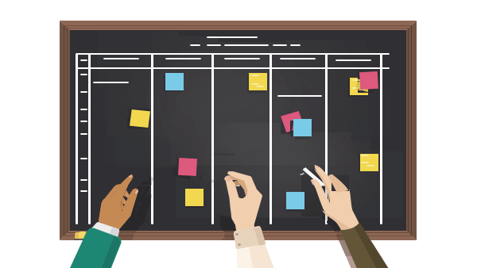
The principles of behaviour
Card sort.. Read through the principles:
1st Rank them from the one that you think is the most important to the least important principle
2nd Now rank them from most challenging to the least challenging for you as a teacher? What makes these more challenging?
Notes:
These are at the end of the presentation. All inspired by Running the Room (Bennett T: 2020)

Slide 3

Practically, what are the key things for creating a classroom with positive learning behaviour?
Put your ideas on the post its (one on each).
Then categorise them. You decide on the categories.

Slide 4
Things that are key
Set the bar high, have high expectation from the start. Command the room.
Don’t use quite.. Be specific.. Ask for silence when you want it an mean. Make all your instructions clear.
Know your pupils and take an interest in them
Teach learning behaviours along side manging misbehaviour
Make expectations totally clear… not ‘you need to listen’… ‘turn around face the front, stop talking’
Have entrance and exit routines : stand behind chairs and get equipment out
Strategic Seating plans
Be consistent
Non verbal behaviour management techniques
Getting pupils onside
Take ownership of your own classroom.
Use thank you
It is hard work to be on it all the time… but it pays off in the end.
Be on it from the start…set the tone for year.
Don’t call for back up too soon
Notes:
Talk through these ideas as key things that the basics of behaviour management. Those that are underlines linked to further examples and information. These can then be used an read theough by staff individually as further support
Non verbal behaviour management techniques (see page 25 of 60s CPD)
Getting pupils onside (pg28-29 60s CPD)

Slide 5



Have Entrance and Exit Routines
Why Classroom Routines Are Important • TechNotes Blog (tcea.org)
Classroom Routines and Procedures: Why Are They Important? - Classroom Management Expert
Notes:
Why Classroom Routines Are Important • TechNotes Blog (tcea.org)
Classroom Routines and Procedures: Why Are They Important? - Classroom Management Expert

Slide 6



Setting the bar high this year!!!!
Notes:
10 Classroom Management Tips for the Classroom – YouTube https://www.youtube.com/watch?v=a94DKCtRvI0

Slide 7
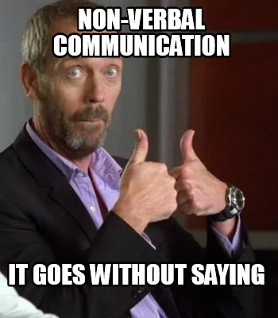
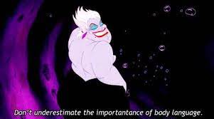
What do we mean by non-verbal communication?
What do you use in the classroom?
Notes:
Ask staff to discuss what methods they use and why they are effective
Discuss use of the pause, use of arms and eye brows, position in the room. the look! We do lots of these without even thinking. Don’t under estimate their power.

Slide 8


Notes:
https://www.youtube.com/watch?v=fCQ-ggrr4KE
https://blog.getselected.com/2018/09/27/use-non-verbal-communication-to-improve-classroom-engagement/
60 Second CPD is great for ideas here. Page 25. 60 second CPD: Beech and Morrison McGill (2020)

Slide 9



Getting the pupils on side
What ideas do you have?
Notes:
Ask staff their views.. Could so mind map in groups.
60 second CPD: Beech and Morrison McGill(2020) Page 28 and 29 have some great ideas.

Slide 10

But what do we do when all we have put in place does not work?
Read one piece of the guidance each and then share this with your table. What do other feel about it? Have got you your own examples of this idea? Is it any good? Could you do it better?
Notes:
Explain that sometimes you put all of these strategies in place and still there is a problem. So what do you do when things are not working.
Staff could take one piece of guidance and then read through and feed back to their table. Discuss, analyse. Add own input and example’s.
These books provide great examples to use
Getting the buggers to behave examples .. Pages 218-231.
Words of warning - page 16 60s CPD 60 second CPD: Beech and Morrison McGill(2020)
De escalating challenging behaviour ( pg17 60s CPD) 60 second CPD: Beech and Morrison McGill(2020)
Troublesome classes (pg41 60s CPD) 60 second CPD: Beech and Morrison McGill(2020) Don’t need all of this one.
De escalating issues (The Behaviour Manual pg254-257) The Behaviour Manual: Strickland S (2022)

Slide 11

Notes:
Explain that there has been lots of information and that this will be on the shared area. There are further video links and I will try to add more examples to the things that are key section (hyperlinks to examples … could scan in book pages) Just take a minute to discuss (coaching style) your own behaviour management.

Slide 12
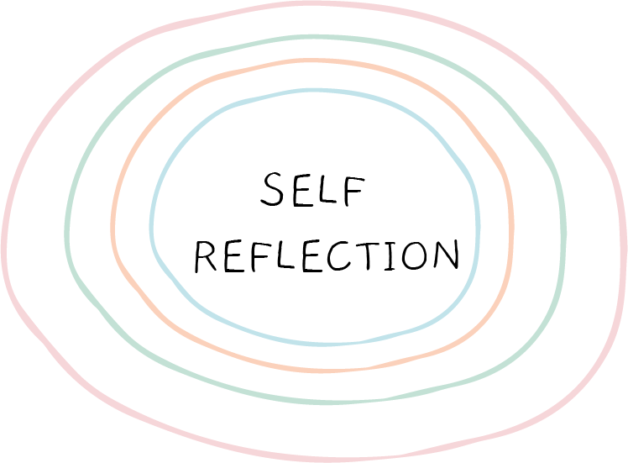
Ask your self these questions, discuss in pairs if you feel comfortable.
Do you have consistent routines for every lesson?
Do pupil often ask what is coming next?
Are your lesson plans always carefully considered?
Do you always follow the school behaviour policy?
Do you treat all pupils equally?
Do transitions between activities feel smooth and seamless?
Are your expectations the same every day?
Has the behaviour in your classroom been unpredictable or inconsistent?
Notes:
These are not meant to be judgy in any way… just self reflective and joining together all of the information that has been looked at. Just sharing on tables/ in pairs, not with all. Give staff time to finish on this. This is great practice of being reflective practitioner and often brings out valuable ideas and discussion.

Slide 13
Not all pupils are the same.
Different students are motivated by different things and in different ways. A teacher should use a variety of methods to engage and onside as many as possible.
Notes:
All inspired by Running the Room (Bennett T: 2020)

Slide 14
Behaviour Can and Must be Taught
It is not something that happens by magic. Pupils have to learn habits, behaviour aptitudes and values.
Notes:
All inspired by Running the Room (Bennett T: 2020)

Slide 15
Make it easy to behave.
Make your classroom a place where pupils want to behave. Remove obstacles where possible that prevent pupils from creating good habits. Contest poor behaviour every time.
Notes:
All inspired by Running the Room (Bennett T: 2020)

Slide 16
Build good relationships and have high expectations.
Consistency, rules, routines and fairness help to build relationships between teachers and pupils. Teachers need to make clear and constantly uphold those high expectations. This is hard work but worth it.
Notes:
All inspired by Running the Room (Bennett T: 2020)

Slide 17
It is all about community
Behaviour is strongly influenced by other people. Students' social nature means that there are hugely influenced by peers and their opinions. You teach a class and that has a group dynamic. That needs to be kept in mind with behaviour management techniques.

Slide 18
Consistency is Key
For a behaviour to become a habit it needs to be carried out consistently and repeatedly.
Notes:
All inspired by Running the Room (Bennett T: 2020)

Slide 19
Everyone wants to feel valued
Students need to know that they do matter in your classroom and that they do belong. This will stop them from seeking this elsewhere
Notes:
All inspired by Running the Room (Bennett T: 2020)

Slide 20
You are the adult and the authority figure.
With this comes great responsibility. Teachers need to be passionate, empathic, fair, consistent and emotionally intelligent in their approach. They need to have presence.
Notes:
All inspired by Running the Room (Bennett T: 2020)

