Slide 1

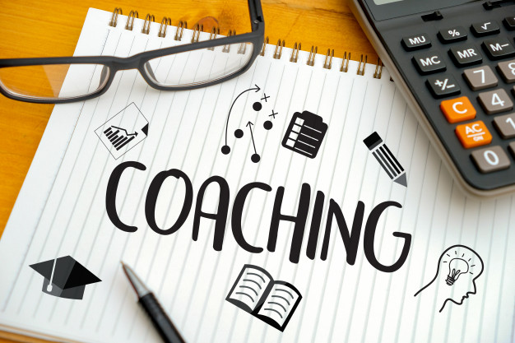

Notes:
This ppt can be used for whole staff CPD, or small group CPD on what the coaching method that they will be starting is all about. The key is to ensure staff feel fully aware of the process as this helps to alleviate concerns and can help to get more teachers onside from the start.
Copyright 2023
<a href="https://registrationoffice.copyrighthouse.org/directory/index.php?cmd=listall&order=5&key=Matthew P H&page=1" target="_blank" rel="noreferrer noopener" class="btn btn-success"><img src="https://registrationoffice.copyrighthouse.org/images/copyrighthouseseal.png" /></a>

Slide 2
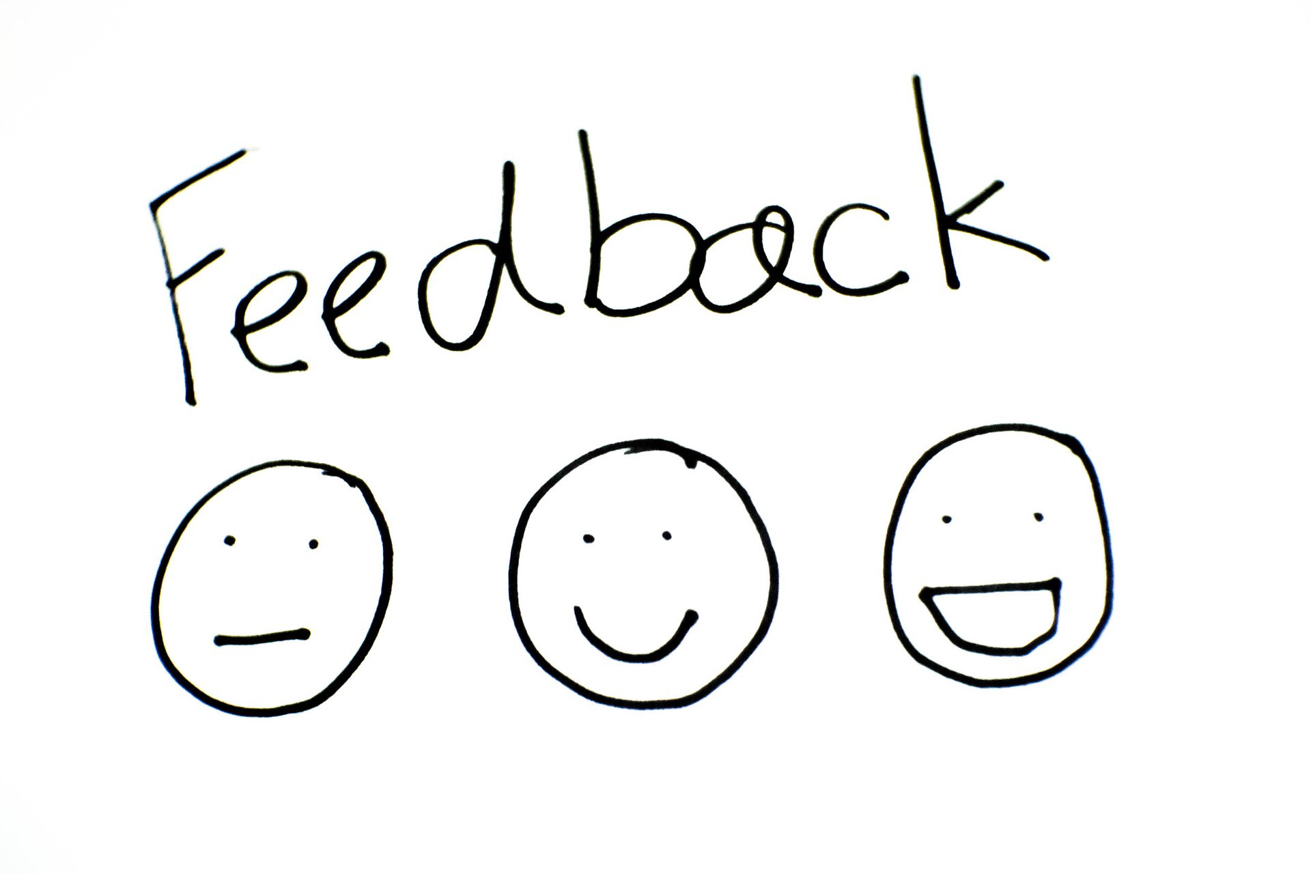
Notes:
As teachers we are used to giving feedback. We give verbal feedback everyday in lessons, formative feedback in books and summative feedback in tests. We often give feedback to peers, trainees and ECTs about their teaching practice in a lesson, or over a period of lessons. However, this often leaves very little time to give feedback to ourselves. To consider where we are in our professional practice, what qualities we have and what changes can help us cope better with the stresses and pressures of the role of a teacher. Indeed, these may change at different points in ana academic year, and our possibilities, both at home and in school. Nether the less it is important for teacher wellbeing that time is given to allow teachers to reflect on themselves and enables them to make personal and professional progress. The role of the coach is to be a facilitator for self-reflection. Their job is not to tell the coachee what to do or how to be. They ask questions to enable the coachee to reflect and evaluate their own strengths and areas for development and how each of these may impact their own teaching practice. It is all about active listening and self reflection

Slide 3

Notes:
The coaching process that you will be embarking on is a all about wellbeing and self improvement. Coaching is not instant, and it is also not about you being told what to do. It is a person-centered approach, where through conversation and active listening of the coach, the coachee is able to reflect on themselves and move themselves forward.
The coaching has two strands; reflection on the feedback and reflection on the process. The first draws on information from the profile and asks the coachee to consider how they felt. It is not matter if the person does not agree with what was said as this in itself can start the conversation between coach and coachee. The second section; reflection on the process asks the coachee to consider their response and feelings to the completing (or not completing) of the profile. Was any threat felt? How did they respond to the feedback? Did a time constraint on the task alter their perception or attitude? The key part of this is to then reflect on what we ask of students in the classroom and how each of these may affect their ability to access and make progress. For example, a competitive pupil may thrive in a timed, high challenge environment, whereas a reserved pupil would be hindered by that style of task. How we give the pupils feedback is also something to be considered here.

Slide 4




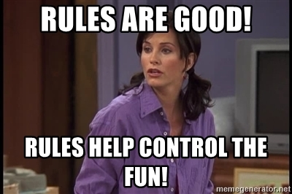
Task Time
#sorrynotsorry
You need to make a paper aeroplane in pairs –
One of the pair can talk but cannot touch the paper in any way (they cannot do any of the physical making). The other person can touch the paper but cannot talk. You should work as a team.
Notes:
(the aim of this task and the reflection on it is to give the teachers a brief taster of what coaching is. This is quite important as so many people confuse this. We found that being clear about the direction, intent and impact from the start make sit clear what the process is and helps to get people on board. This method is not instruction coaching. It is about the coachee being asked questions by the coach and them reflecting on themselves.)
So, now it is time for you to do a task. You need to get into pairs. One of the pair can talk but cannot touch the paper in any way… they cannot do any of the physical making. The other person in the pair can touch the paper, but cannot talk at all. Work as a team… you have 3 minutes… Go!

Slide 5

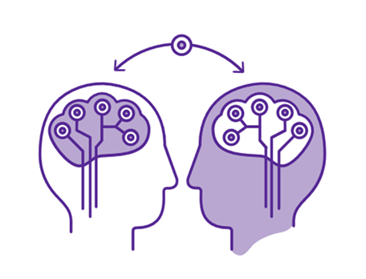
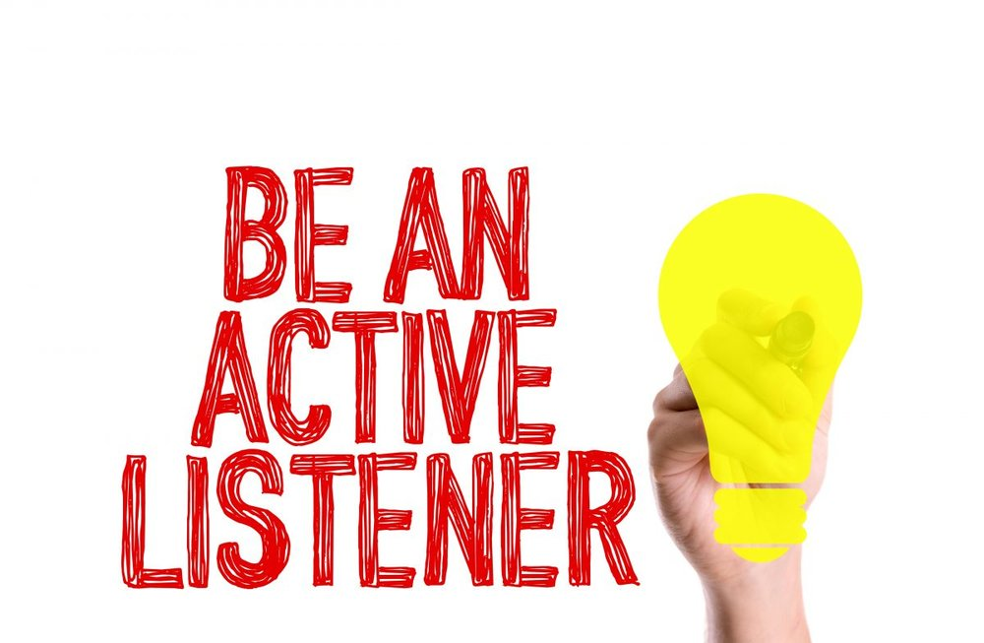
What did you learn about yourself?
Did anything surprise you about the task or how you reacted?
How did you work as part of the pair?
What happened during the task?
How did the experience
make you feel?
How can you apply insights from this activity to your teaching?
How did you behave / respond / react?
Notes:
Now you need to join with another pair… everyone can talk again now!! One pair needs to be the coach… asking the questions, while the other answers as the coachee. Then swap roles. You have 4 minutes for this. Go.
(Then bring everyone back together)
What you have just done is very simple versions of coaching meeting. You can see the sorts of open questions that are used to get the coachee thinking themselves about their skills and how they reacted. Sometimes we can surprise ourselves with how we react or perform in a situation and it is important to take the take to reflect why this was. You should have also noticed the ‘be and active listener graphic’. It is so important that the coaches adopt this. So often in situation we look like we are listening in conversation but we are not fully taking in what is being said. The coaching sessions enable a time set aside for fully focused meeting where the coachee is really listened to. This in itself can be an invaluable tool for wellbeing. Just giving someone your undivided time.

Slide 6

Coaching is an ongoing partnership, built on trust, respect and openness, with the key aim of support
The role of the Coach is to help the individual identify areas of change and help with strategies to explore these
A primary purpose will be goal setting, not by the Coach, but the ‘Coachee’
This is turn will feed back into Teaching and Learning, as the process progresses…
Notes:
This just adds a little more about what coaching is. (read though the slide ready to expand on the process outline)

Slide 7
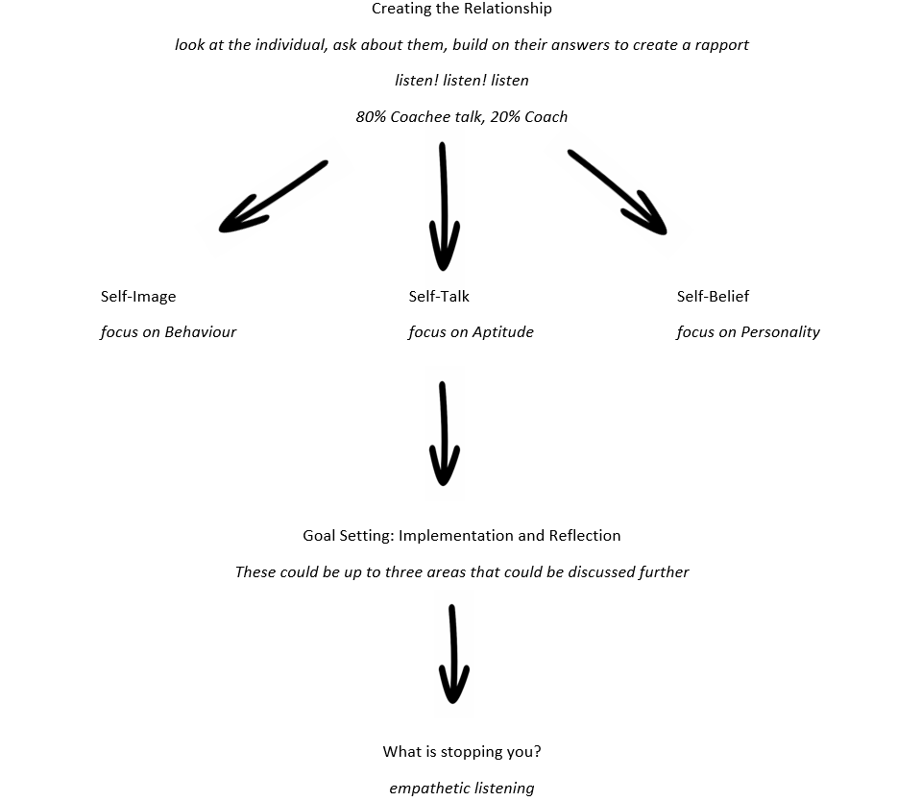
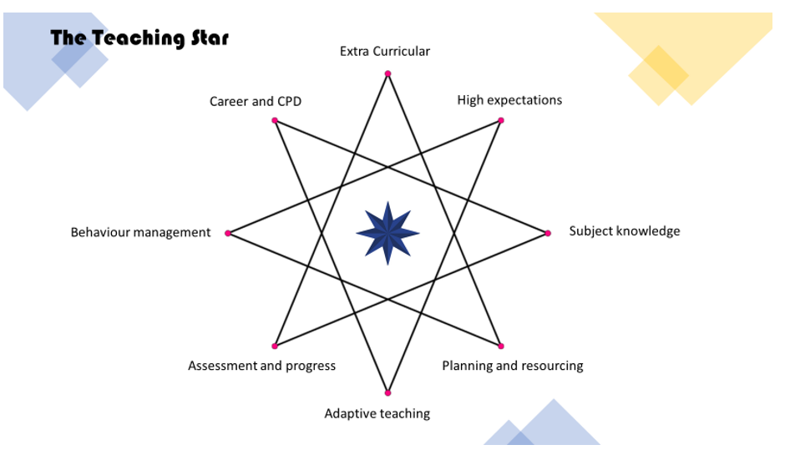

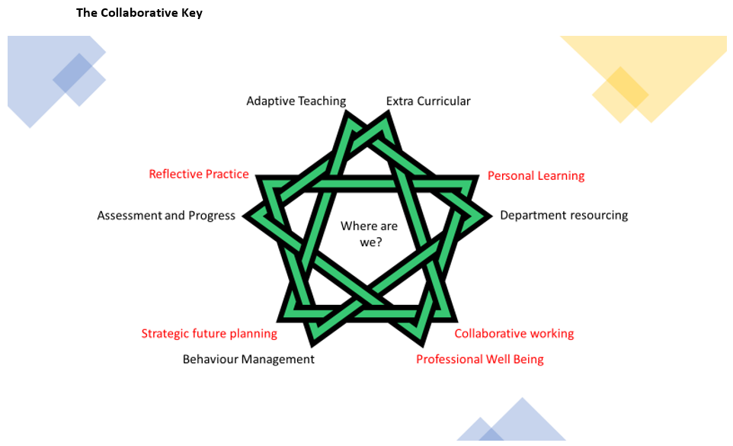
Notes:
This is the process over the three year model. You will be assigned a coach at the start of the process who will facilitate your reflection throughout the year. Each year has a different focus that develops from the previous year. The aim is that there will be 6 sessions each year (one per half term) and each will last about 20 minutes. Some may be longer, but we are aware that time is another pressure on teachers, so the coaching needs to be manageable within the teacher workload. Eventually the process should help you with your wellbeing and even your time management.
The first year focus is personal wellbeing (shown through the self talk, self image and self belief diagram) and will give time to reflect on the personality profile that you will do at the start of this term.
The second year focus is professional wellbeing and is based around reflection on the points of the teaching star. This focuses on teacher standards, as well as skills central to the profession.
The third year is participative wellbeing. During this year the model adapts to a collaborative method. Departments use the Collaborative Key, along with the skills and reflection from the previous years (a cumulative curriculum model) to develop each other and contribute to further whole school improvement.

Slide 8

Notes:
This is absolutely central to the process. Any conversations with the coach will be confidential. It is important that coachees also recognize this. The only time things will not be confidential is when a coach considers something to be a safeguarding concern. This should then be dealt with as any safeguarding procedures are in school.

Slide 9

Notes:
Remember that this is all about self reflection. Being a reflective practitioner is one of the teacher standards, but teachers often have very little time to this properly. This model aims to give them the opportunity to this while advancing their professional practice and wellbeing.

Slide 10
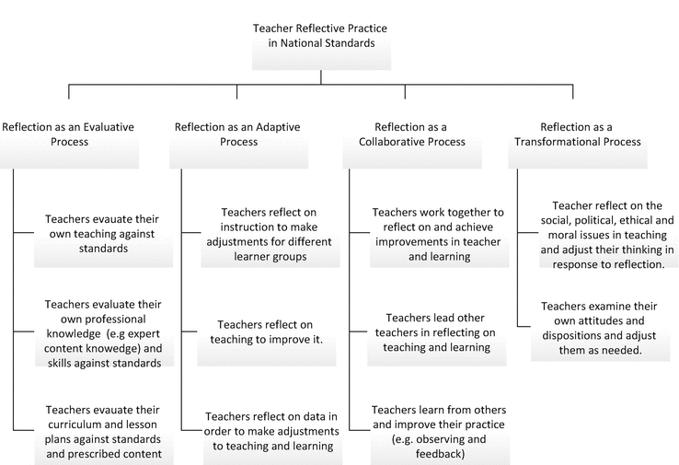
(Glasswell and Ryan 2017: reflective theory and practice in teacher education)
Notes:
Glasswell and Ryan emphasize the importance of reflective practice and even highlight that collaboration is part of this. Their research clearly shows that this then pulls together to be part of a transformational process.
Here you can see the range of skills that are part of reflective practice and the huge impact that they can have on professional development.

Slide 11
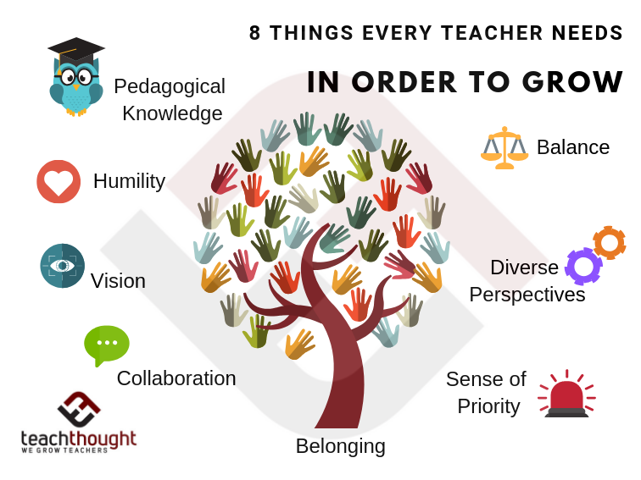
A distinctive quality of very good teachers is that their practice is the result of careful reflection ... They themselves learn lessons each time they teach, evaluating what they do and using these evaluations to adjust what they do next time.
(Why Colleges Succeed, Ofsted 2004, para. 19
(Heick T: 2017 Things Every Teacher Needs To Grow - teachthought.com)
Notes:
Being a reflective practitioner is one of the teacher standards and clear skill that needs to be nurtured
One of the teacher standards is focused on being a reflective practitioner and there is lots of evidence to suggest that a reflective teacher has the most success in the classroom as they have both a strategic and empathetic approach to the pupils that they teach. . It is important on so many levels. Not only does it enable a teacher to critically reflect on their teaching practice within a lesson but enables a teacher to have an emotionally intelligent approach to the planning and delivery of their lessons. This can have a huge impact on adaptive teaching and ensure that teacher is thinking from the perspective of the many learners in their class, rather than just their own.
T Heick of teachthought emphasizes the many qualities above that help a teacher to grow (Heick T: 2017 Things Every Teacher Needs To Grow (teachthought.com) Coaching will enable you to develop and refine these skills to enable you to grow as a professional.
These skills are not only important with the classroom but within the wider school community, with peers and managers. The coaching model that we will embark on enables the nuture and development of your personal wellbeing and then your professional wellbeing. This then leads on to a collaborative approach within departments.
For coaching to be successful, it is imperative that the process is not linked to line mangers, SMT, performance management or the QA process, hence why coaches have been chosen from outside of this.

Slide 12


Notes:
You will be informed about coach and coachee matches over the next few weeks. Don’t hesitate to come and ask any questions about the process. We really want it to help you as individual and you as professional practitioners.
Copyright 2023
<a href="https://registrationoffice.copyrighthouse.org/directory/index.php?cmd=listall&order=5&key=Matthew P H&page=1" target="_blank" rel="noreferrer noopener" class="btn btn-success"><img src="https://registrationoffice.copyrighthouse.org/images/copyrighthouseseal.png" /></a>

