Slide 1
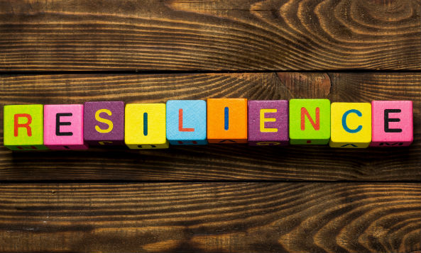
Notes:
This can be sued for whole staff CPD, small group CPD, or aspects of this can even be used with pupils.

Slide 2
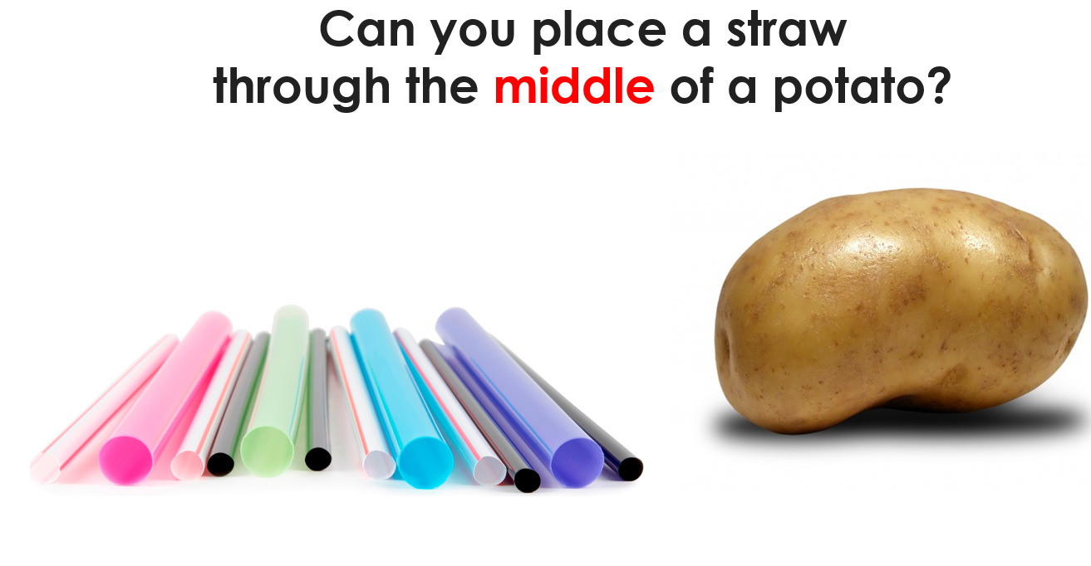
Notes:
‘Get that straw through the potato’. A year 10 boy did it instantly.. After task, discuss how this links to relssinece. You had different potatos, straw, tricky task but you did not give up. Very few moaned about the unfairness of the task. This would highlight that your resilience is good. Often, some of our students do not react in quite the same way.

Slide 4
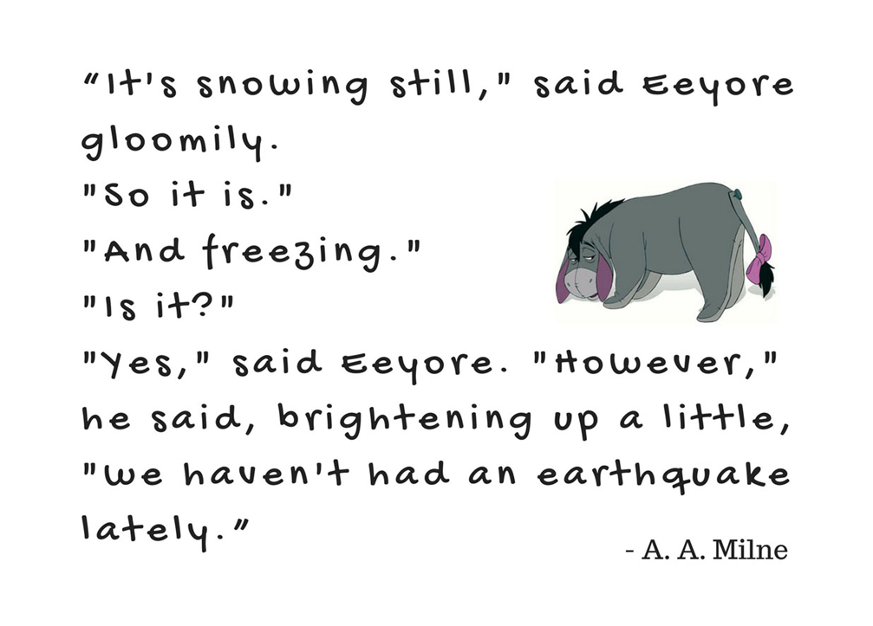

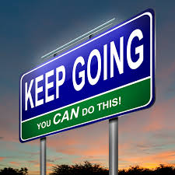
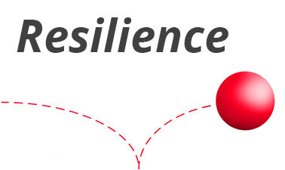
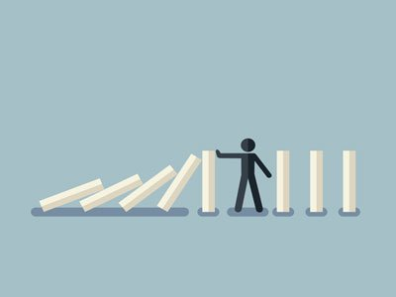
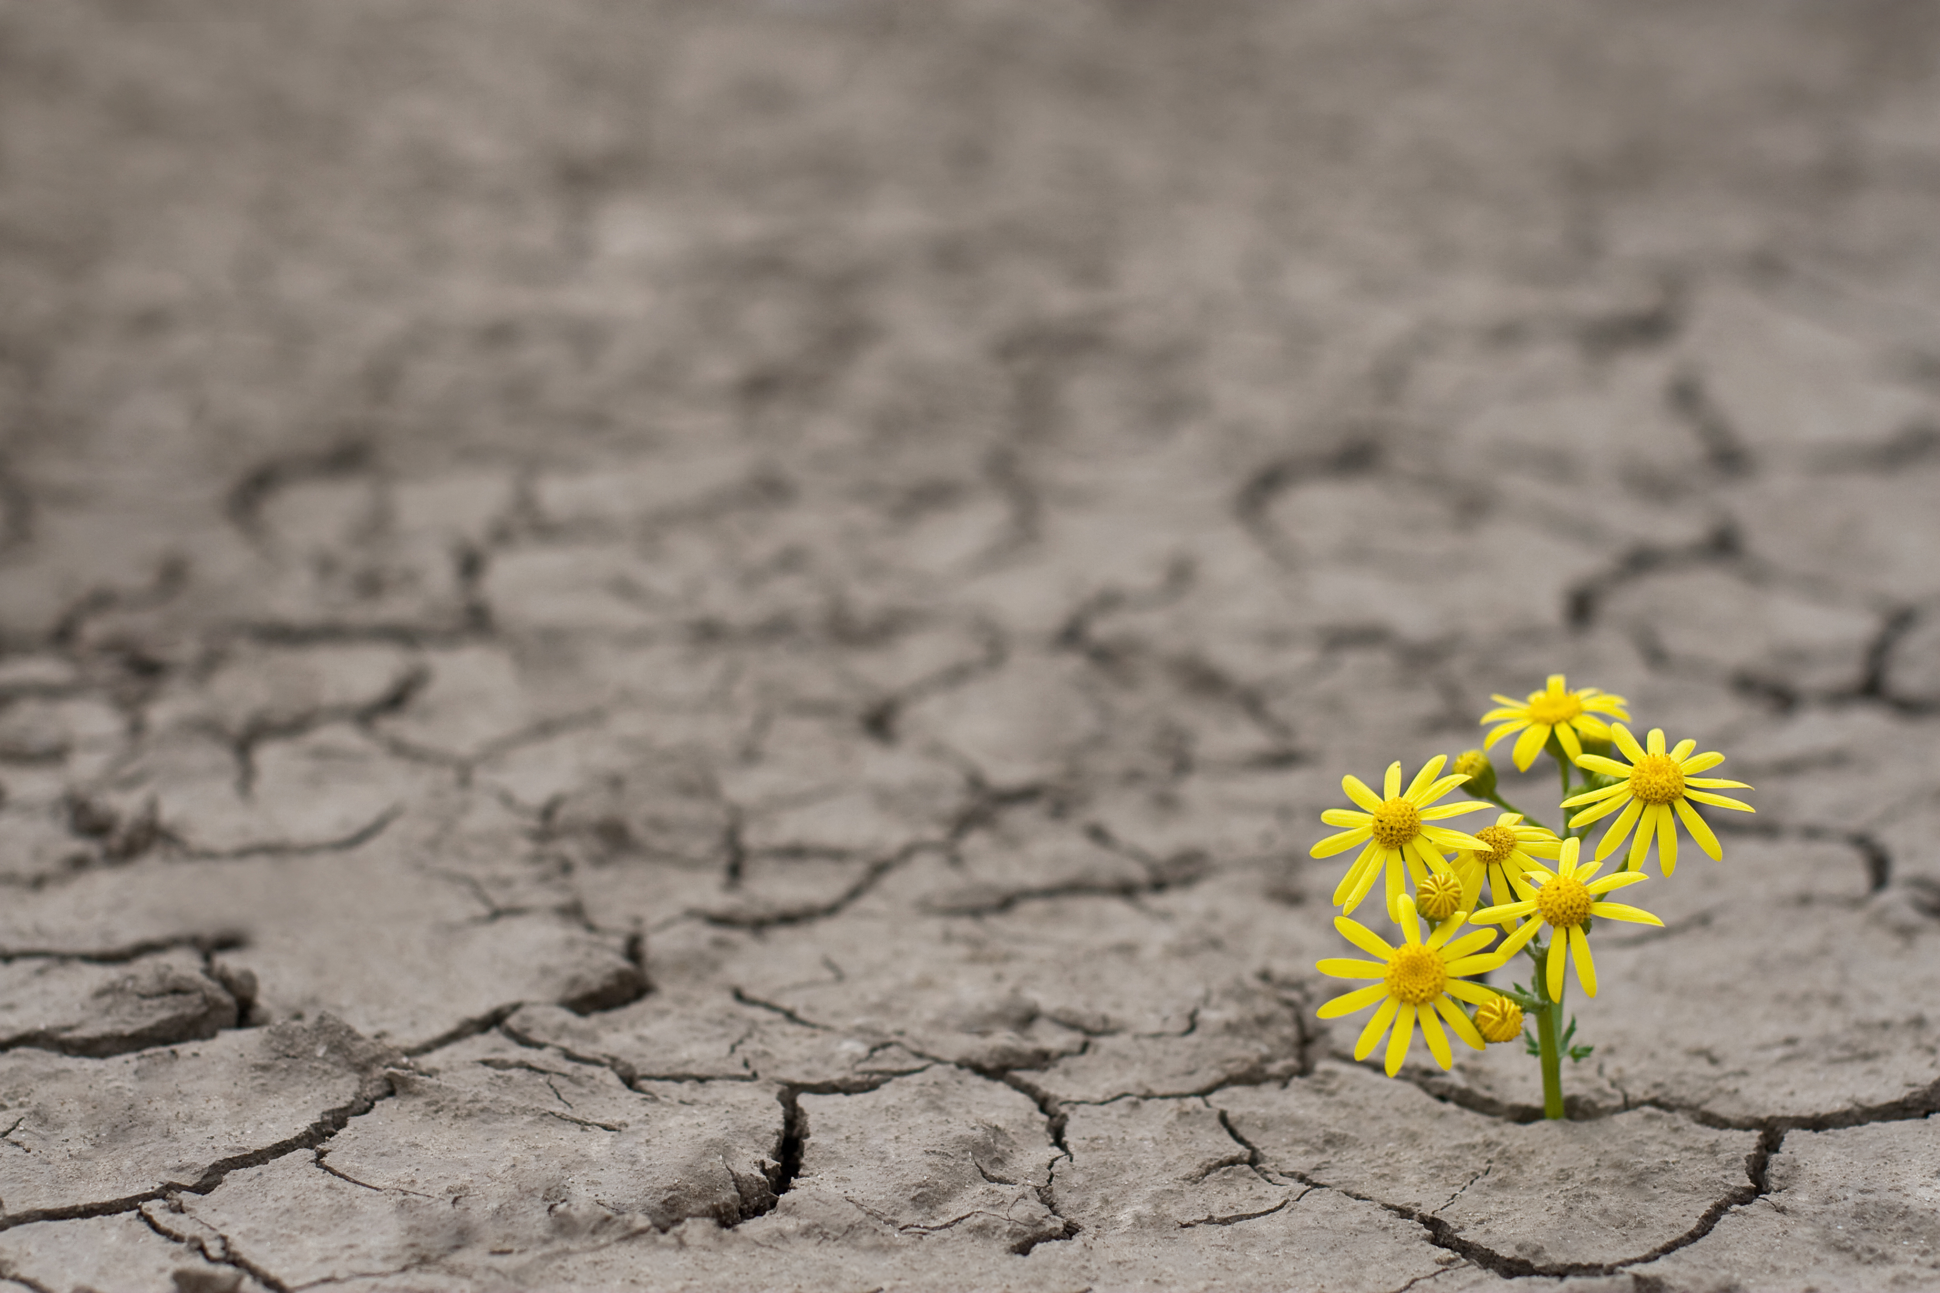

Notes:
Could ask them to discuss which image best represents what we mean by resilience in the classroom/ school environment
Could explain that I found this tricky as the was a lot of what I would consider ‘airy fairy’ info but maybe it is only through this gradual moulding approach that we can change as the resilience is the initial problem.

Slide 5
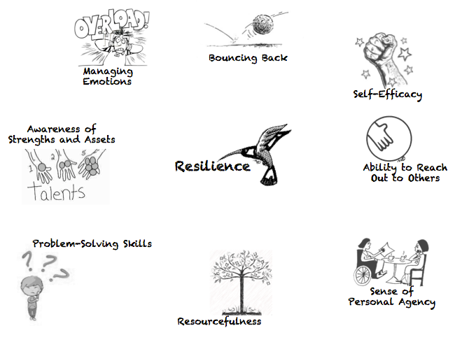
Notes:
Key skills to being resilient.

Slide 6
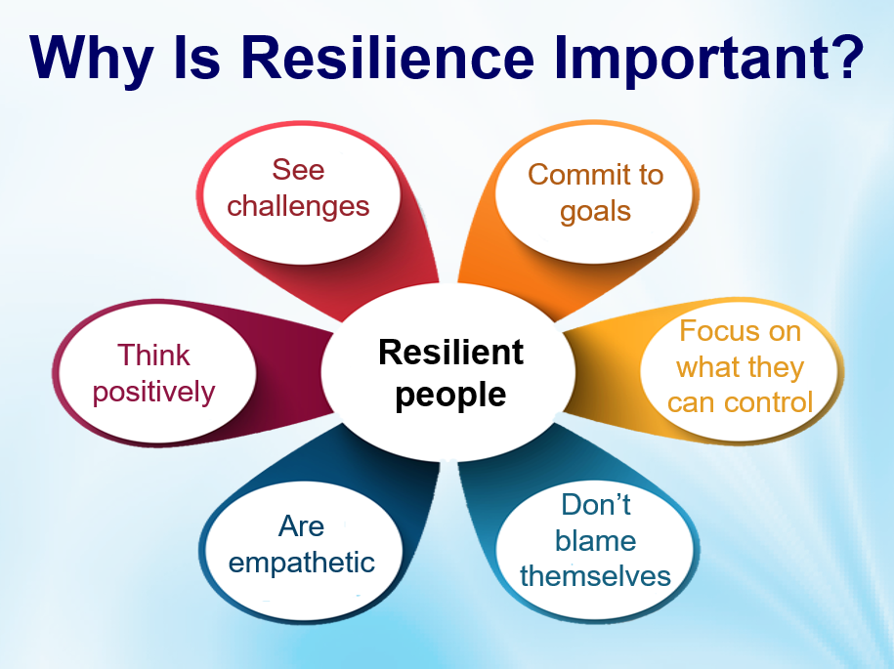
Notes:
Link to learning in school. All this help with pupil progress as well as wellbeing, achievement and character building. Also good for building a community.

Slide 7
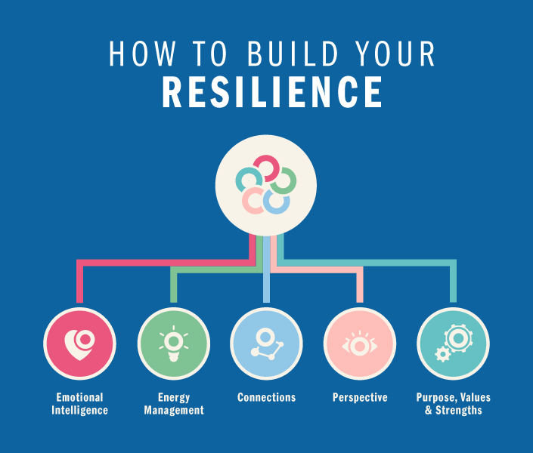
Notes:
What sorts of things would be under each of these headings? Work in groups to formulate ideas. Feed back. Which are easier for a teacher to do and why?

Slide 8

Str
Notes:
So we know what it is and what we need to do… we now need to look at how??? Give a range of strategies to each table…. Discuss them … would you use them would they be any good? Are some more appropriate than others… can you share any ideas that you have done?
These strategies can be found from a variety of sources… here are some ideas: The first one is great for strategies
https://www.google.com/url?sa=t&rct=j&q=&esrc=s&source=web&cd=&ved=2ahUKEwin752Z8f7-AhXTNsAKHaijC7QQFnoECAsQAQ&url=https%3A%2F%2Fschools.au.reachout.com%2F-%2Fmedia%2Fschools%2Ffiles%2Fpdf%2Fbuilding-resilience-in-young-people.pdf%3Fla%3Den%26hash%3D28060620774202C31A33BCBD87000925826E8AFF&usg=AOvVaw31jp1RMlvA3lqG3un_D0--
Resilience classroom activities | ReachOut Schools
Resilience for teens: 10 tips to build skills on bouncing back from rough times (apa.org)
Charity Shop | Support Young People's Mental Health | YoungMinds
Self Care, Anxiety, Depression, Coping Strategies | On My Mind | Anna Freud Centre

Slide 9
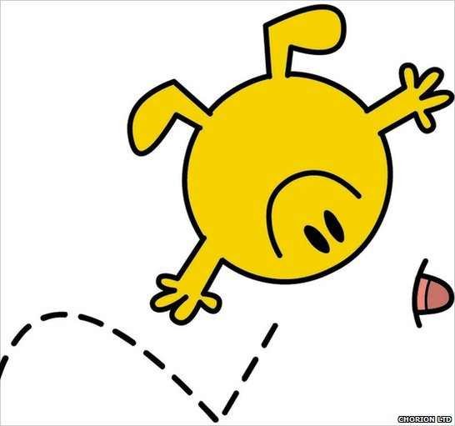
B – Bad times don’t last, and things get better.
O – Other people can only help if you share with them.
U – Unhelpful thinking only makes you feel worse.
N – Nobody is perfect – not you, not your friends, not your family, not anybody!
C – Concentrate on the good things in life, no matter how small.
E – Everybody suffers, everybody feels pain and experiences setbacks; they are a normal part of life.
B – Blame fairly – negative events are often a combination of things you did, things others did, and plain bad luck.
A – Accept what you can’t change and try to change what you can.
C – Catastrophizing makes things worse – don’t fall prey to believing in the worst interpretation.
K – Keep things in perspective. Even the worst moment is but one moment in life.
Notes:
Some key take aways on resilience. (slides 10, 11 12 too)

Slide 10

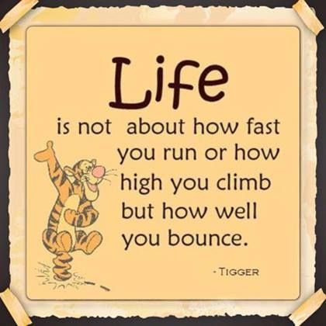

Slide 11
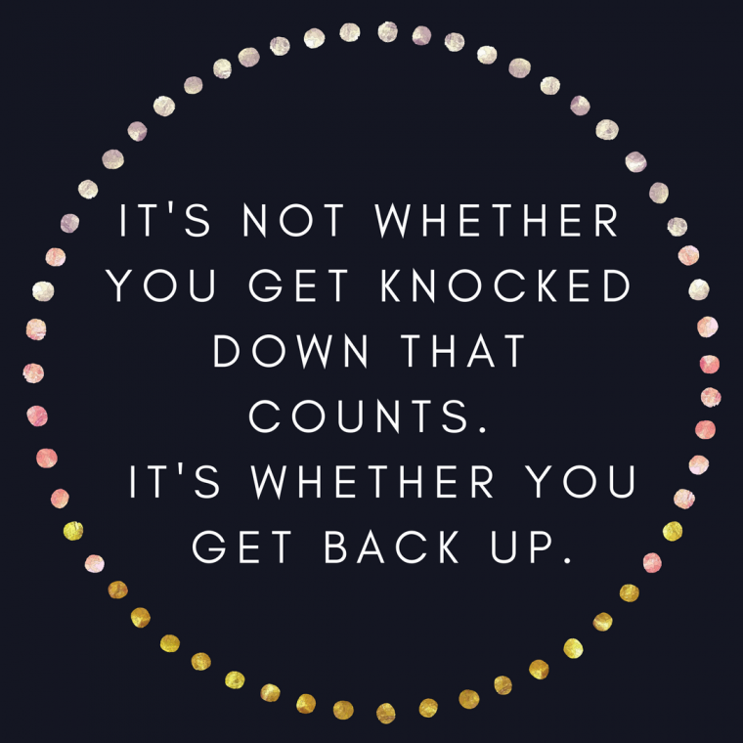

Slide 12
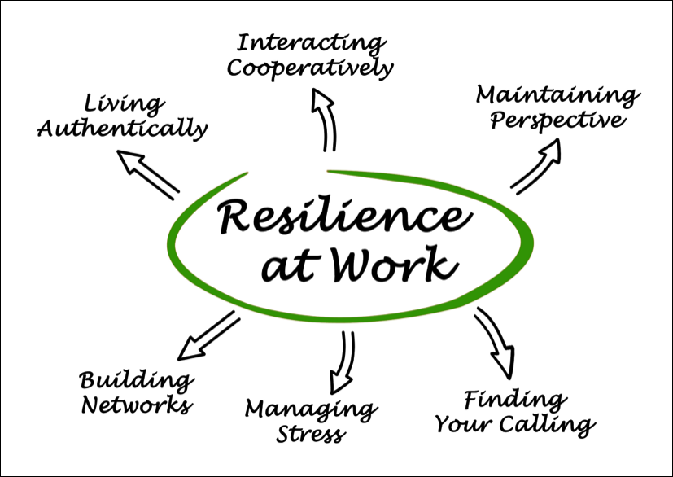
Notes:
Useful for both staff and students.

