Slide 1

Term 3
I can…
Copyright 2023
<a href="https://registrationoffice.copyrighthouse.org/directory/index.php?cmd=listall&order=5&key=Matthew P H&page=1" target="_blank" rel="noreferrer noopener" class="btn btn-success"><img src="https://registrationoffice.copyrighthouse.org/images/copyrighthouseseal.png" /></a>

Slide 2
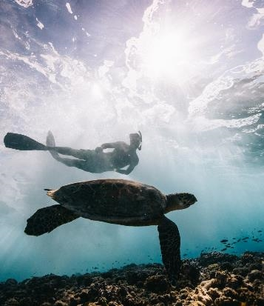
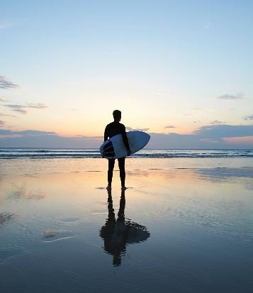

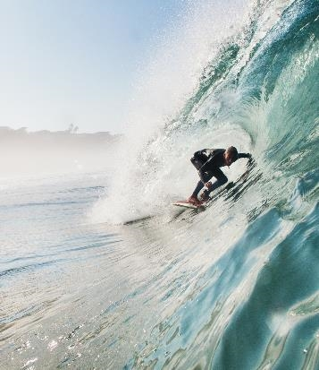

Resilience
  How was Term 2 placement, what did you learn?
  What do you remember from last term’s Coaching?
  What is your preferred working style currently? (This question will be interesting when you compare and contrast with Phase 4)
  What do you want to take away from our time together today?
  What would you most like to talk about?
  What would be the biggest win of this session today?
  Let the conversation grow and rebuild those connections from term 1.
  Try to end with a positive outlook for the
  next session…’I’m looking forward to
  seeing you next time and catching up.’
Copyright 2023
<a href="https://registrationoffice.copyrighthouse.org/directory/index.php?cmd=listall&order=5&key=Matthew P H&page=1" target="_blank" rel="noreferrer noopener" class="btn btn-success"><img src="https://registrationoffice.copyrighthouse.org/images/copyrighthouseseal.png" /></a>

Slide 3
Adaptability
  How do you handle a situation when unexpected obstacles occur in a lesson?
  How do you approach learning new skills?
  How do you deal with criticism?
  What impact has this had on your Wellbeing?
  What could give you more clarity on this?
  How do you handle situations when you have to work with a new colleague?
  How do you handle situations when you encounter resistance in a classroom?
  Remember it is not an interview,
  80% Coach talk, so keep listening!
Copyright 2023
<a href="https://registrationoffice.copyrighthouse.org/directory/index.php?cmd=listall&order=5&key=Matthew P H&page=1" target="_blank" rel="noreferrer noopener" class="btn btn-success"><img src="https://registrationoffice.copyrighthouse.org/images/copyrighthouseseal.png" /></a>

Slide 4
Resource
  How do you feel pupils engage with your resources?
  How do you create a resource and then implement into a lesson?
  Are they appropriate to the needs of the pupils? How?
  What variety of resources do you use in a lesson?
  Is it OK to share resources? Why?
  This is an exercise in reflection,
  not blame culture, keep it positive,
  reflective and then forward thinking
Copyright 2023
<a href="https://registrationoffice.copyrighthouse.org/directory/index.php?cmd=listall&order=5&key=Matthew P H&page=1" target="_blank" rel="noreferrer noopener" class="btn btn-success"><img src="https://registrationoffice.copyrighthouse.org/images/copyrighthouseseal.png" /></a>

Slide 5
Time Management
  What have you already accomplished?
  What has worked for you?
  What has not?
  Why is it important to manage your time effectively?
  Can you give an example of when you prioritised tasks?
  How do you organize your daily activities?
  What is a good work life balance for you?
  What is the most challenging aspect of teaching from a time management perspective?
  How do you stay organised?
Copyright 2023
<a href="https://registrationoffice.copyrighthouse.org/directory/index.php?cmd=listall&order=5&key=Matthew P H&page=1" target="_blank" rel="noreferrer noopener" class="btn btn-success"><img src="https://registrationoffice.copyrighthouse.org/images/copyrighthouseseal.png" /></a>

